Slide 1
Computer Vision Project
ID
OOD Detection with CORES
for Monocular Depth Estimation
FastDepth and METER · NYU Depth V2 → KITTI
OOD
Vincenzo Fonseta · Simone Parrella

Slide 2
1 · INTRODUCTION
Why OOD Detection Matters
1
The Problem
2
The Idea
3
The Challenge
Outside the training domain, an MDE model produces plausible but unreliable depth maps, without signaling uncertainty.
CORES, originally built for classification, uses convolutional kernel responses to build a score that separates ID and OOD data.
Dense prediction has no logits or classes: the monitored layers, spatial reduction, and decision threshold all need to be adapted.
Goal Are the internal convolutional responses of an MDE network enough to discriminate ID and OOD data? And how does this capability depend on the adaptation choices and the architecture?
2

Slide 3
2 · EXPERIMENTAL SETUP
Dataset: NYU Depth V2 and KITTI
 | NYU Depth V2 (ID) | KITTI Depth Completion (OOD)
Scene | Indoor: offices, kitchens, bedrooms | Outdoor street scenes, from a moving car
Sensor | Microsoft Kinect (RGB + depth) | Velodyne LiDAR
Resolution | 640×480 | ≈ 1242×375 (different aspect ratio)
Depth range | Up to ≈ 10 m | Up to ≈ 80 m
Depth map | Dense, with validity mask | Sparse: only LiDAR-hit points
Role | Training, calibration, ID test | OOD evaluation only
Shared preprocessing resize 224×224 · depth rescaled (10 m / 80 m) · ImageNet normalization
3

Slide 4
2 · EXPERIMENTAL SETUP
Four Distinct Data Splits
Training
Calibration
Test
Test
85%
15%
ID
OOD
of the NYU training set
of the NYU training set: threshold and scoring hyperparameters
NYU test set: false-positive evaluation
KITTI: final evaluation only
Calibration is never used for gradient updates
Random split with a fixed seed, reproducible across runs
ID test and KITTI are used only for final evaluation
4

Slide 5
2 · EXPERIMENTAL SETUP
The Two Models (from the Papers)
FastDepth
METER
Lightweight CNN for real-time on embedded devices
Hybrid CNN-transformer for embedded devices (4 GB)
Encoder: MobileNet (original V1; pretrained V2 in this project) with depthwise conv.
Decoder: 5 NNConv5 blocks (5×5 depthwise + 1×1 pointwise, nearest upsampling)
Additive skip connections
Encoder derived from MobileViT: MobileNetV2 blocks + METER block (transformer on patches)
Convolutional decoder with transposed convolutions and skip connections
S, XS, XXS variants: 3.29M, 1.45M, 0.71M parameters
5

Slide 6
2 · EXPERIMENTAL SETUP
Evaluation Metrics
Depth Estimation
OOD Detection
Metric | What It Measures
AbsRel | Mean relative error |pred − gt| / gt
RMSE | Mean squared error, in meters
δ₁ δ₂ δ₃ | % of pixels with max(pred/gt, gt/pred) < 1.25 · 1.25² · 1.25³
Metric | What It Measures
AUROC | P(ID score > OOD score); 0.5 = no discrimination
FPR95 | False alarms on ID when 95% of OOD is detected
Acc. / Prec. / Rec. / F1 | At the calibrated threshold, OOD = positive class
TNR | % of ID correctly classified as ID; expected ≈ 0.95
Balanced Acc. | Average of recall and TNR (290 ID vs 1000 OOD)
6

Slide 7
3 · ARCHITECTURE
CORES in a Nutshell
Premise
1
Per-Kernel Extremes
For each kernel, only the positive max and negative min of the response map are kept.
ID Data
high peaks, deep troughs, many active kernels
2
Four Metrics
RM⁺/RM⁻ (magnitude beyond the τ thresholds) and RF⁺/RF⁻ (frequency of kernels beyond threshold). The four quantities are combined into the single-layer CORES score.
OOD Data
muted responses, few active kernels
3
Multi-layer Score
The layer score is aggregated along a trajectory of kernels identified via backtracking.
7

Slide 8
3 · ARCHITECTURE
Structure of the Two Implementations
Input 3×224×224 → output 1×224×224 · BerHu, AdamW, OneCycleLR, 40 epochs · 10 monitoring points (E0–E4, D1–D5)
 | FastDepth | METER
Stage 0–2 | MobileNetV2, pretrained | Identical
Stage 3–4 | MobileNetV2, pretrained | Inverted-residual + METERBlock, random weights
1×1 + BN projections (tap E0–E4) | 64, 128, 256, 512, 1024 channels | 64, 128, 256, 384, 512 channels
Decoder | 5 NNConv5: nearest upsample, 5×5 depthwise | 5 blocks: bilinear upsample, 3×3 depthwise
Decoder channels | 512, 256, 128, 64, 32 | 384, 256, 128, 64, 32
Skip connection | Sum after ReLU | Sum before ReLU
Output | 1×1 Conv + ReLU (raw tap) | Identical
Taps are BatchNorm before ReLU: in the encoder, those of the projections; in the decoder, those of each block's pointwise.
8

Slide 9
3 · ARCHITECTURE
How the Score Is Computed
1
Hook
2
Spatial Reduction
3
Four Metrics
Single forward pass with hooks on 10 pre-ReLU BatchNorm taps (5 encoder + 5 decoder)
Peak and minimum per channel on the H×W map
RM⁺, RM⁻, RF⁺, RF⁻ with per-layer τ thresholds
4
Layer Score
5
Layer Averaging
6
Decision
S = λ₁·(logRM⁺+logRM⁻) + λ₂·(logRF⁺+logRF⁻)
λ₁=2, λ₂=1, ε=1e-4
One score per sample
Threshold = 5th percentile of ID validation; below threshold = OOD
Two Scoring Variants | Non-selected | Selected
Layers averaged | All 10 | D1–D5 only
Channels used | All channels | Subsets from backtracking
RM⁺ and RF⁺ | Computed on all channels | Computed on positive subset (far-region lineage)
RM⁻ and RF⁻ | Computed on all channels | Computed on negative subset (near-region lineage)
Paper equation | Eq. 5 | Eq. 9
9

Slide 10
3 · ARCHITECTURE
Backtracking Without Classes
Seed
Channels Kept at Each Step
Farthest 10% and nearest 10% of pixels of the raw output (analogues of c_max and c_min)
D5 channels weighted by the final 1×1 conv: top 20% per side
Step | Layer | Weights Used | FastDepth | METER
Seed | D5 | Final 1×1 conv | Top 20% | Top 20%
1 | D5→D4 | pointwise up5 | 13 of 64 | 13 of 64
2 | D4→D3 | pointwise up4 | 26 of 128 | 26 of 128
3 | D3→D2 | pointwise up3 | 51 of 256 | 51 of 256
4 | D2→D1 | pointwise up2 | 102 of 512 | 77 of 384
Climbing from D5 to D1
Same rule for FastDepth and METER: sum of pointwise 1×1 weights (up5, up4, up3, up2) of the already-selected channels → TopK (positive) and BotK (negative), 20% of the previous layer
Stops at the decoder: skip connections are unweighted sums and the encoder is unreachable
10

Slide 11
3 · ARCHITECTURE
Problems and Solutions (1/2)
Problem | Adopted Solution | Remaining Limitation
No classes or FC | c_max and c_min become the farthest and nearest depth regions | “Far/near” is not equivalent to “predicted class”
Backtracking | Decoder only (D5 → D1) | Skip connections are unweighted sums: the encoder is unreachable
Pre-ReLU taps | BatchNorm before ReLU to preserve RM⁻ and RF⁻ | Encoder stages have no clean tap
Encoder taps | Added 1×1 + BN projections, randomly initialized | Taps sit on a thin adapter, not on the backbone
11

Slide 12
3 · ARCHITECTURE
Problems and Solutions (2/2)
Problem | Adopted Solution | Remaining Limitation
Transformer in METER | Taps read the projections only | Transformer responses are never evaluated directly
Numerical stability | Log-space, λ₁=2 (vs. 10 in the paper) | Departs from the original formula
Thresholds | Per-layer τ on noise, threshold at 5th percentile of ID validation | The selected score reuses the non-selected τ
Spatial reduction | Peak and minimum per channel on the H×W map | More than a single pixel extreme: τ needs recalibrating
12

Slide 13
3 · ARCHITECTURE
Differences from the Papers
Aspect | FastDepth (paper → project) | METER (paper → project)
Encoder | MobileNet V1 → pretrained MobileNetV2, 320→1280 conv removed | MobileViT from scratch → 3 MobileNetV2 stages pretrained + 2 random METERBlocks
Transformer blocks | – | More blocks → only 2
Decoder | NNConv5 → NNConv5 with added projections | 3 blocks with transposed conv → 5 blocks with bilinear upsample + depthwise
Loss & training | L1 → BerHu, AdamW, OneCycleLR | Balanced loss + shifting augmentation → BerHu, OneCycleLR, no augmentation
Size & input | – | S 3.29M, XS 1.45M, 256×192 → ≈2.5M, 224×224
14

Slide 14
4 · EVALUATION
Depth Quality and Calibration
1
Depth Quality
2
Calibrating the τ Thresholds
ID test only (NYU): verifies the model is a good estimator
AbsRel, RMSE, δ₁–δ₃ on pixels with valid depth (gt > 0.001)
Metrics computed per batch, then averaged
Data: id_val + synthetic noise only
Six percentile candidates (50th–90th) for τ+ and τ−, per layer
Scores on id_val and on 128 Gaussian-noise + 128 uniform-noise images
The candidate with fewest false positives on noise is chosen
15

Slide 15
4 · EVALUATION
OOD Detection: Protocol
Three Disjoint Sets
Evaluation
Set | Role
id_val | Determines the decision threshold
id_test (NYU) | Measures behavior on ID data
ood_test (KITTI) | Measures behavior on OOD data
Higher score = more similar to ID data
AUROC and FPR95: threshold-independent (ID test vs KITTI)
Threshold = 5th percentile of id_val: accepts about 95% of ID
Threshold applied once to the test sets: accuracy, precision, recall, F1, confusion matrix
Expected TNR ≈ 0.95: a very different value indicates mismatched validation and test distributions
16

Slide 16
5 · ABLATION & CHECKS
The Four Experiments
Layer selection
Forward hook
Forward ID + OOD
CORES score
AUROC and FPR95
Experiment | Layer Subsets | Question It Answers
Per-layer | Each layer individually (10 runs) | Which layers are most discriminative?
Group | Encoder only, decoder only, both (3 runs) | Encoder or decoder: where is the information?
Cumulative | E0, then E0–E1, … up to all 10 layers (10 runs) | How does performance change with depth?
Detailed components | A single run, all layers | Which component (RM⁺, RM⁻, RF⁺, RF⁻) separates best?
Detailed components is diagnostic: it does not compute AUROC, but records the mean RM⁺, RM⁻, RF⁺, RF⁻ values for ID and OOD.
17

Slide 17
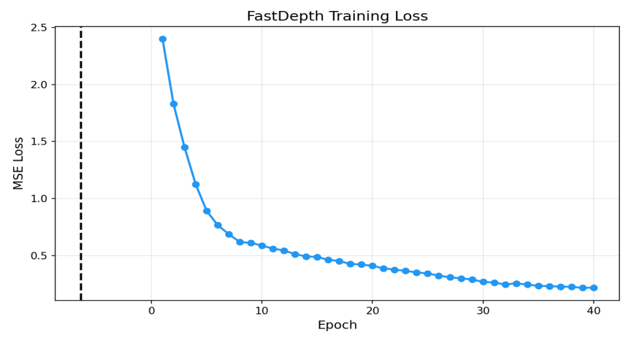
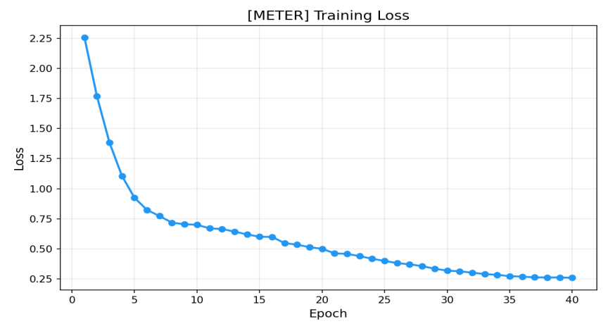
6 · EXPERIMENTAL RESULTS
Behavior During Training
FastDepth (MobileNetV2 + NNConv5)
METER (MobileViT / Transformer + Conv Decoder)
Training behavior on NYU Depth V2 (40 epochs, BerHu loss, OneCycleLR):
• Fast, stable convergence: both models reach a plateau within the first 15–20 epochs, settling at a final loss of ~0.218 (FastDepth) and ~0.259 (METER).
• BerHu stability: combining L1 for small errors with adaptive L2 for large errors avoids gradient oscillations and produces well-calibrated dense predictions.
18

Slide 18
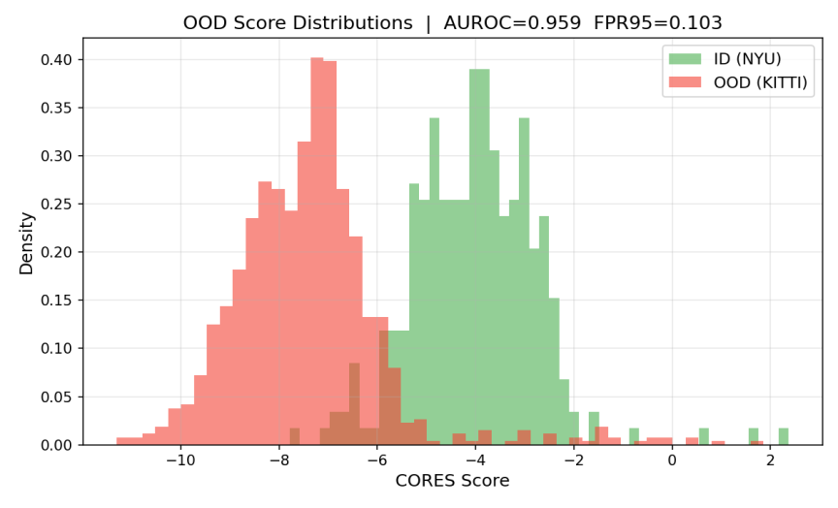
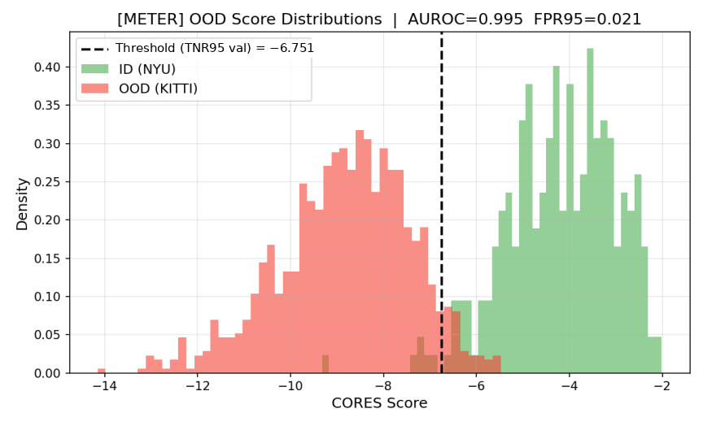
6 · EXPERIMENTAL RESULTS
OOD Detection: FastDepth vs METER
Performance Comparison | ID: NYU Depth V2 (290 test) vs OOD: KITTI Depth Completion (1000 test)
• FastDepth: AUROC = 0.959 · FPR95 = 10.3% · Calibrated threshold (TNR95 val) = −5.35
• METER: AUROC = 0.995 · FPR95 = 2.1% · Calibrated threshold (TNR95 val) = −6.75
Takeaway: Clear bimodal separation in both models. The hybrid CNN-transformer METER cuts FPR95 to a fifth compared to FastDepth, achieving near-perfect OOD discrimination (AUROC 0.995).
19

Slide 19
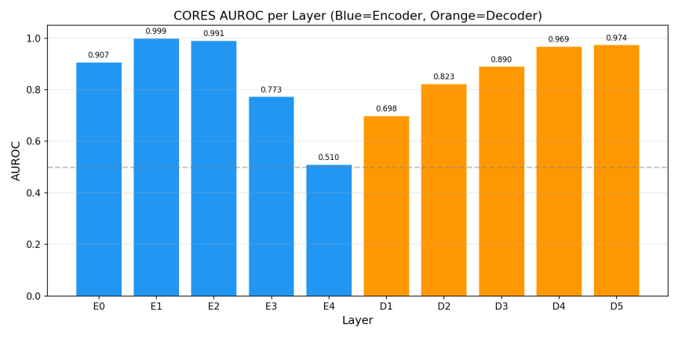
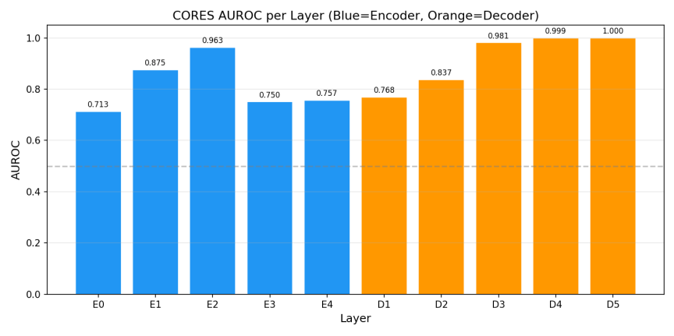
6 · EXPERIMENTAL RESULTS
Ablation: Per-Layer Profile and U-Shaped Trend
Per-layer AUROC analysis (Blue = Encoder E0–E4, Orange = Decoder D1–D5):
• U-shaped trend: strong discrimination in the early layers (E0–E2, AUROC > 0.87–0.99) tied to low-level visual features (Kinect vs outdoor LiDAR sensor statistics).
• Bottleneck (E4): in FastDepth, AUROC collapses to 0.510 (chance level), while in METER the transformer blocks preserve a solid 0.757 thanks to global attention across patches.
• Recovery in the Decoder (D1–D5): discriminative power grows monotonically as the depth map is reconstructed, reaching 0.974 in FastDepth and 100% (1.000) in METER on D5.
20

Slide 20
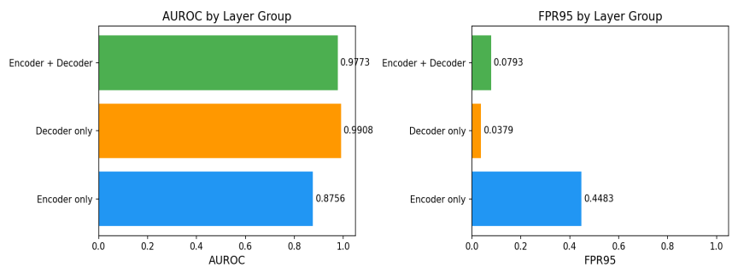
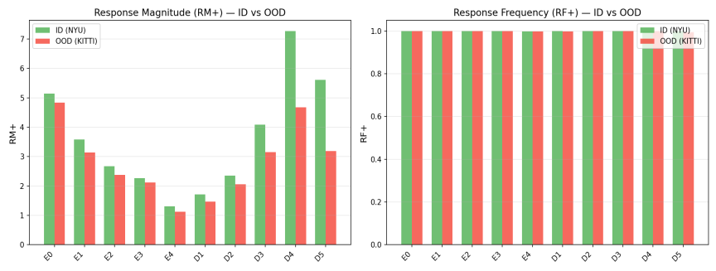
6 · EXPERIMENTAL RESULTS
Ablation: Layer Groups and CORES Components
1. Decoder-Only Beats All Layers
2. RF+ Saturation and RM+ Dominance
In METER: Decoder-only reaches AUROC 0.9908 and FPR95 3.79%, surpassing the Encoder+Decoder combination (AUROC 0.9773, FPR95 7.93%).
Same trend in FastDepth: Decoder-only (0.9525, FPR 9.3%) beats All (0.9430, FPR 16.5%). The encoder's deep layers “pollute” the averaged score.
RF+ saturation: activation frequency (RF+) is 1.0 for both ID and OOD across all monitored layers; it offers no discriminative power.
Separation driven by RM+: the entire OOD score is carried by magnitude (RM+), which in the decoder's final layers registers much stronger ID responses (7.3 vs 4.7 on D4).
21

Slide 21
6 · FINAL RESULTS & CONCLUSIONS
Conclusions and Future Work
1. Effectiveness of CORES on Dense Prediction
2. CNN vs. Hybrid Transformer
Internal convolutional responses are sufficient to discriminate ID and OOD data even without logits or classes (AUROC > 0.95 in both models), confirming the initial research hypothesis.
METER outperforms FastDepth on every metric (AUROC 0.995 vs 0.959, FPR95 2.1% vs 10.3%). The transformer blocks prevent the specificity collapse at the bottleneck (0.757 vs 0.510).
3. Optimization: Monitor the Decoder Only
4. Future Work and Open Limitations
Limiting monitoring to the decoder improves discrimination (removes false alarms from intermediate layers) and halves the number of taps and the compute overhead — ideal for embedded/real-time deployment.
Extend backtracking through the additive skip connections to involve the encoder, and investigate transformer attention as a natural channel selector for the OOD score.
22

